Slide 1
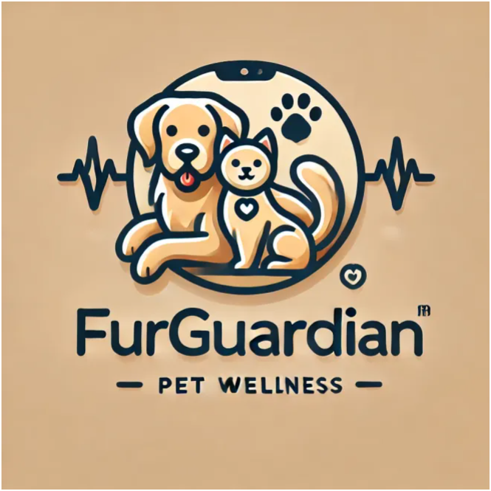
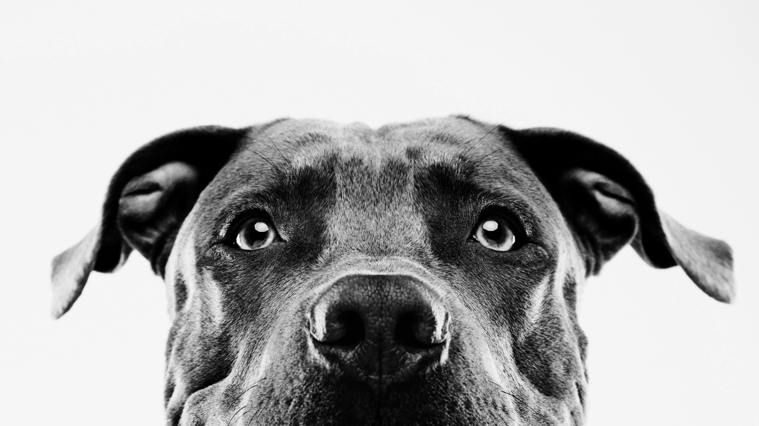
"Caring for your pets’ well-being, every step of the way”

Slide 2
Team Name: FurGuardian
Project Name: Pet Wellness App
Team Group: 8
Student Names and ID’s:
Justin Chipman – N01598472
Imran Zafurallah - N01585098
Zane Aransevia - N01351168
Tevadi Brookes - N01582563

Slide 3
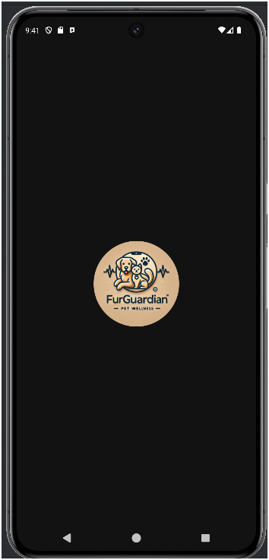
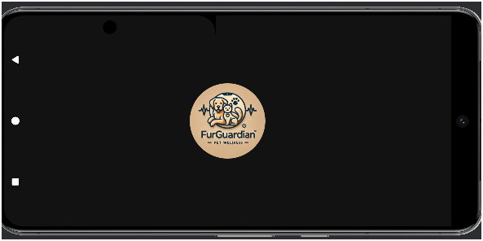
Splash Screen in Portrait mode
Splash Screen in Landscape mode

Slide 4
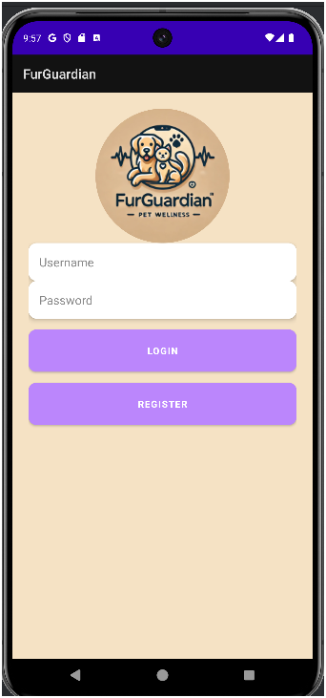
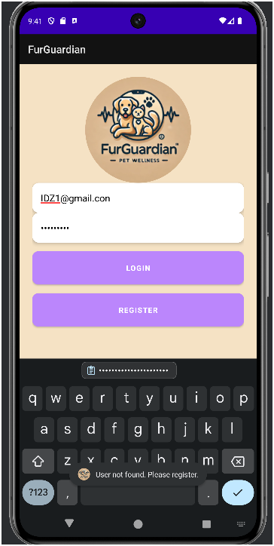
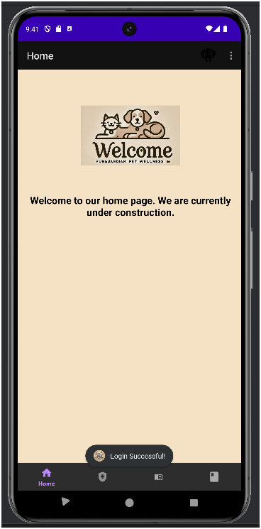
Login Screen
Login Screen for Incorrect login
Login Screen for Correct login

Slide 5
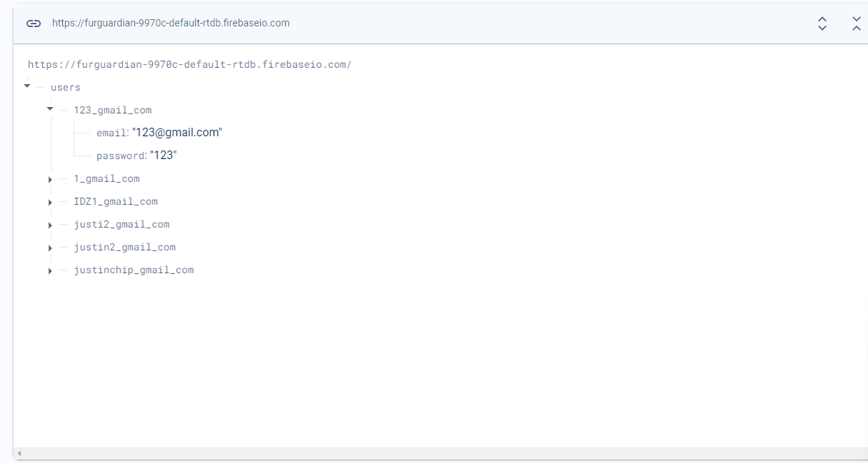
Firebase Database

Slide 6
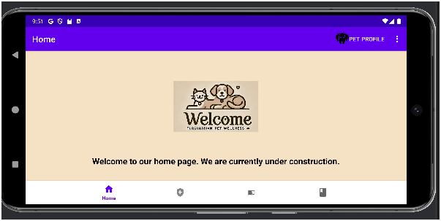
Home Screen in Portrait Mode
Home Screen in Landscape Mode

Slide 7
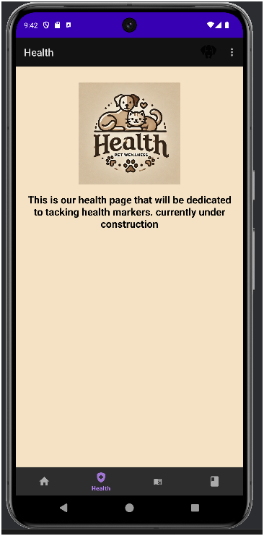
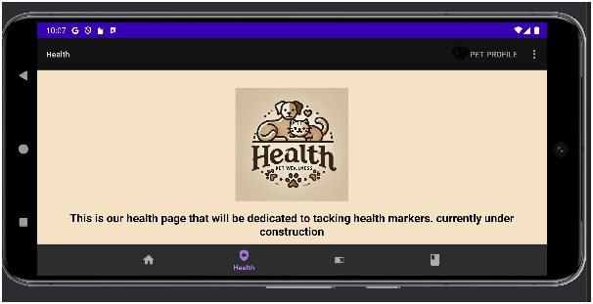
Health Screen in Portrait Mode
Health Screen in Landscape Mode

Slide 8
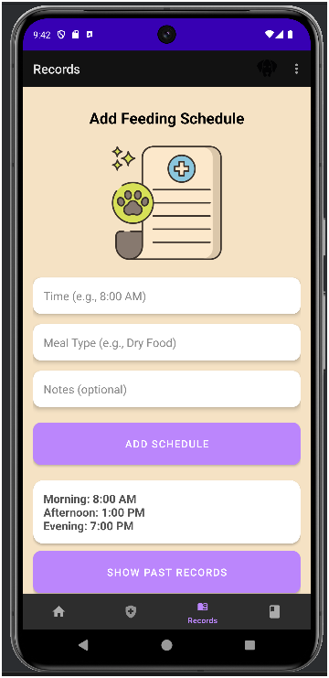
Records

Slide 9
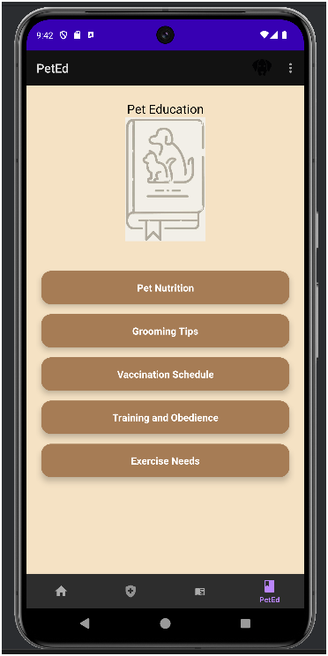
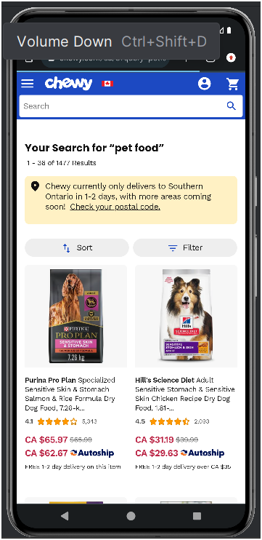
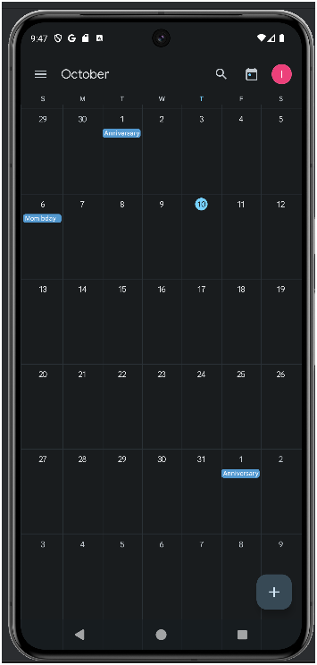
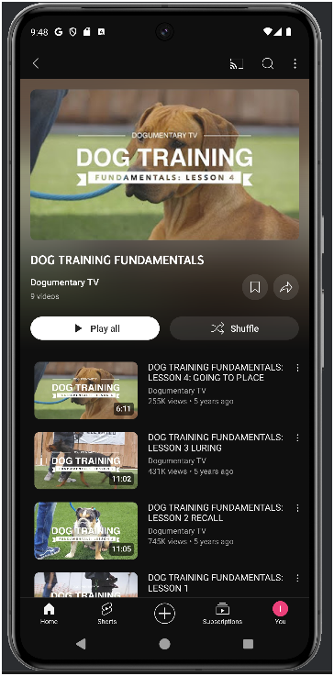
Pet Education
Link to Pet Nutrition
Link to Calendar
Link to Youtube Video

Slide 10
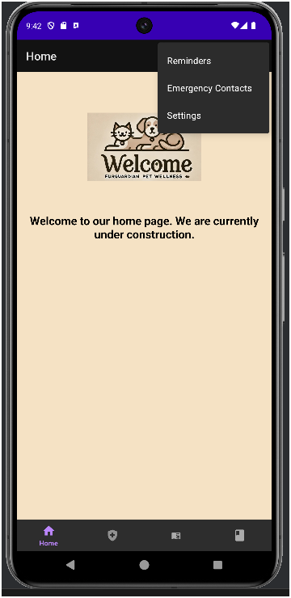
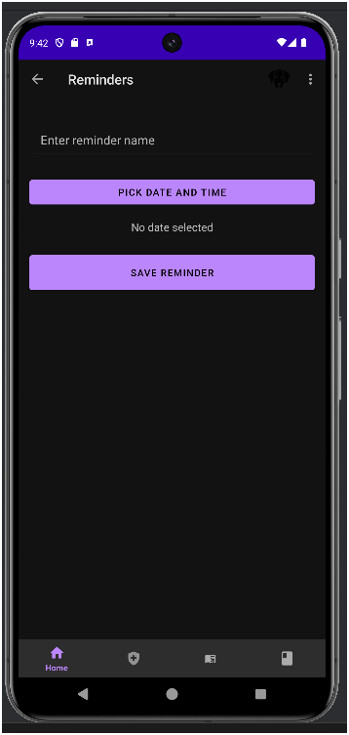
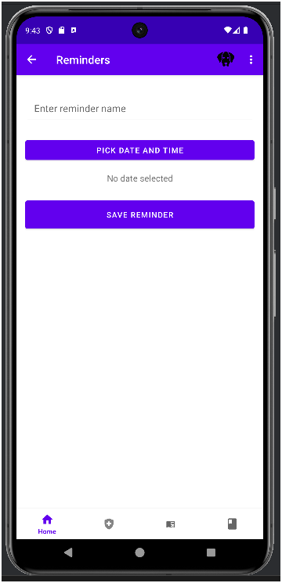
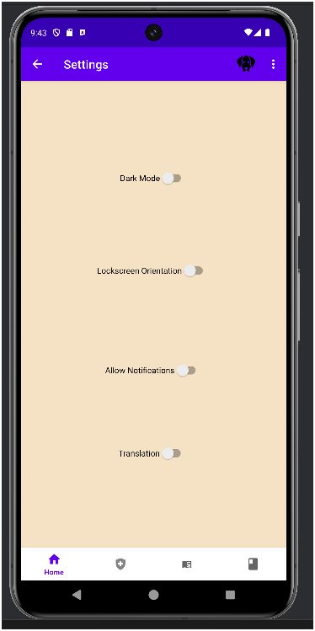
Drop Down Menu
Reminders Dark Mode
Reminders Light Mode
Settings

Slide 11
Business Model canvas
Customer Segments
Pet product retailers (PetSmart, etc...)
Veterinarians
Pet owners
Value Proposition
Real-time pet Health Monitoring
Remote feeding options
Channels
Mobile App
Social Media
Veterinarians
Key Resources
Developers
Cloud infrastructure
Partnerships with veterinarians
Key Partnerships
Partnership with Clinics and veterinarians
Partner with Pet Product Suppliers
IoT device manufacturers
Revenue Streams
Subscription fees
In-app purchases
Hardware sales
Key Activities
App Development
Marketing
Customer support
Cost Structure
Advertisement
Marketing and customer support
App development and maintenance
Customer Relationships
24/7 customer support
Community engagement (forums, etc...)
Personalized notifications

Slide 12
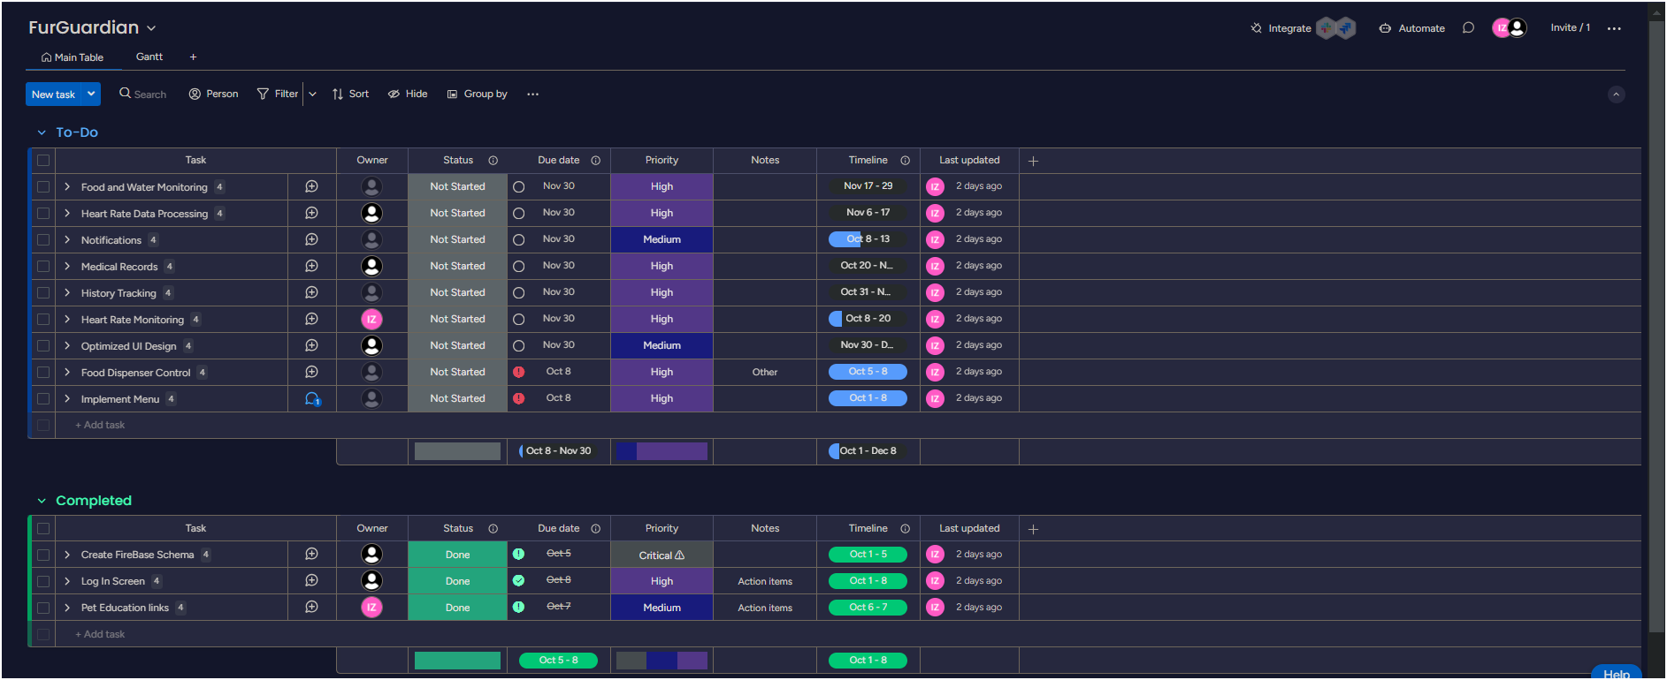
Sprint dashboard

Slide 13
Github Usage
Our GitHub strategy relied on maintaining close communication within the team to ensure seamless collaboration. Team members would notify the group in our Discord chat before starting their part of the project in a new branch, which helped avoid pull errors and conflicts. Everyone made sure to pull the most recent version of the project before beginning their work. Once a task was completed, the member would inform the team, allowing others to proceed with their work. If multiple members needed to work simultaneously, they coordinated to ensure their tasks didn't overlap, preventing merge conflicts and push errors.

Slide 14
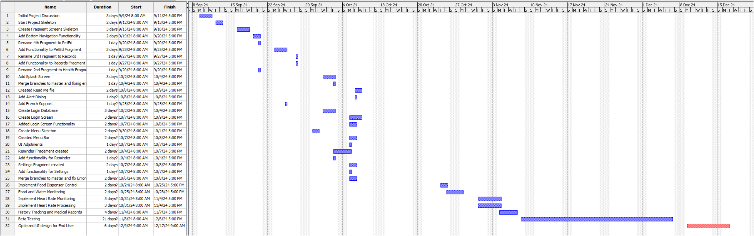
Gantt Chart

Slide 15
Screen flow and Demonstration on Real Device...!!!!

